Slide 1
Evolution of Computer Science: Impact on Society from 1940 to 1984
By: Cole Becker
Date: November 21 2023

Slide 2
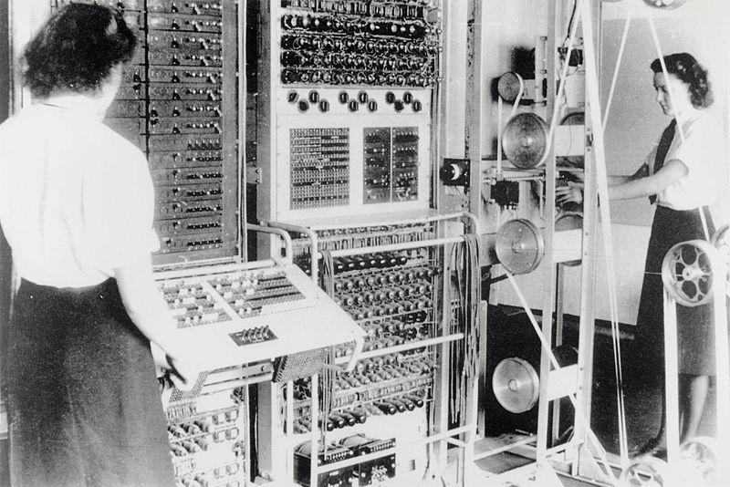
Overview of Computing in 1940-1950s
Colossus Computer
Developed during World War 2
One of the earliest electronic digital programmable computers
Used by british to decipher german codes
Alan Turing's probability in cryptanalysis contributed to its design
Significantly reduced the time spent deciphering
Was improved in a newer version with quintuple the speed
Existence was kept secret until mid 70s
Served as a precursor to modern computers and was fundamental in the evolution of computing

Slide 3
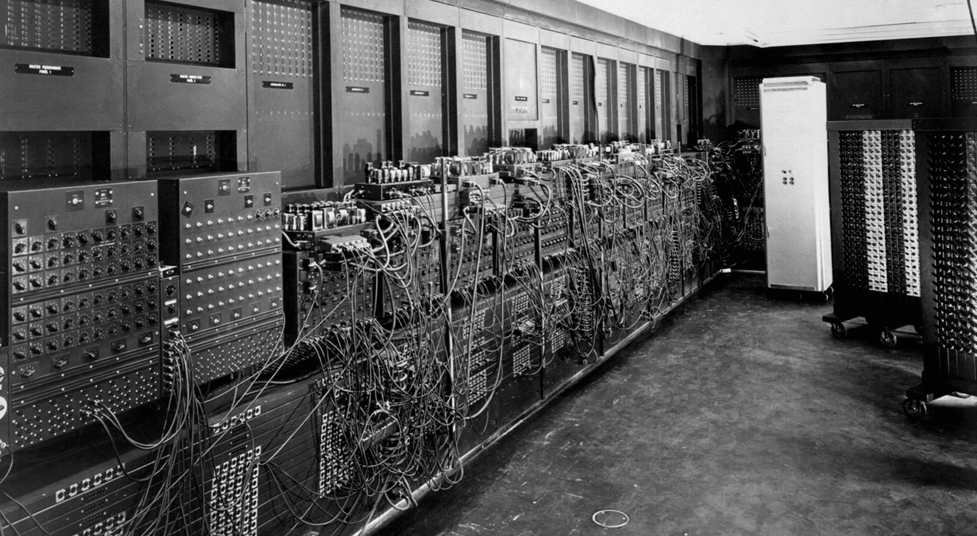
Overview of Computing in 1940-1950s
ENIAC
Completed in 1945
The first general purpose computer
It was massive and had vacuum tubes to perform calculations
Consumed a considerable amount of electricity
Showed the potential for electronic systems to perform tasks
Atomic energy research, weather prediction, and cryptography
Sparked the idea to make computers smaller, faster and more energy efficient
Lead to the increase in investment in computer research

Slide 4
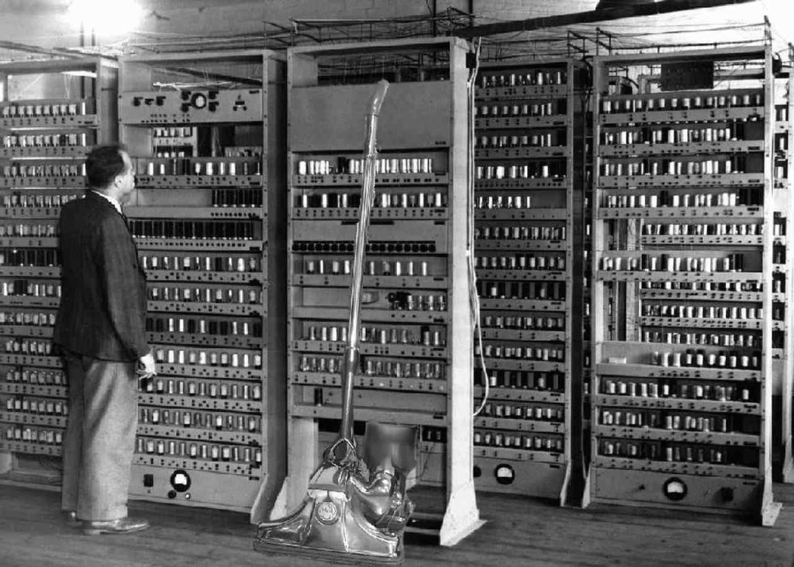
Overview of Computing in 1940-1950s
EDVAC
Electronic stored-program computer
Project initiated by John von Neumann
Design greatly influenced what's now known as the von Neumann architecture
It stored both data and instructions in the same memory space, allowing instructions to be fetched and executed sequentially
Binary system used binary code for representation/processing
Foundation for subsequent computer architectures and advancements in modern computing technologies

Slide 5
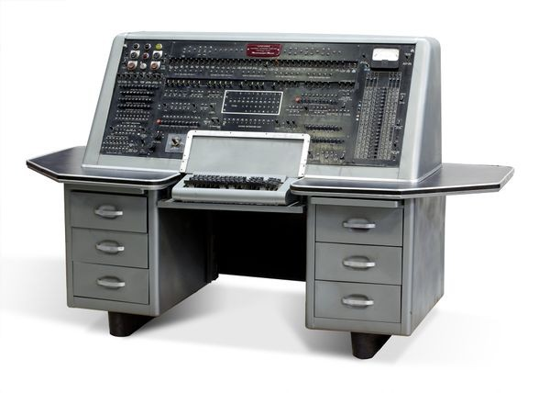
Overview of Computing in 1940-1950s
UNIVAC
First commercial computer of its kind
Made a shift from computing primarily being a government or research endeavor to being used in businesses and orgs
Could handle both numeric and alphabetical data
Predicted the outcome of 1952 election
Groundwork for handling different types of information which is essential to modern computing
Its existence and combabillites was the foundation for modern computing from being massive machines

Slide 6
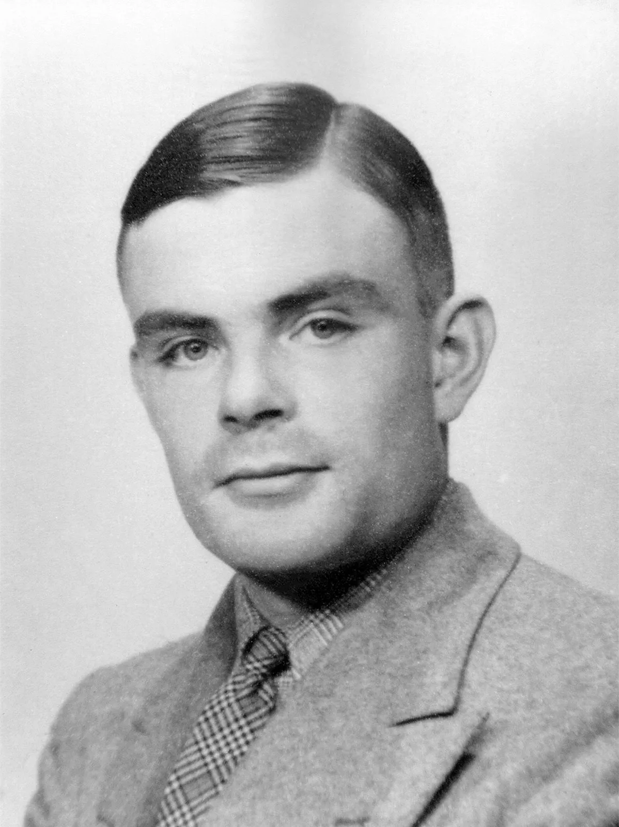
Overview of Computing Pioneers
Alan Turing (1912 - 1954)
Went to University of Cambridge
Turing Machine: a device that could manipulate symbols on a strip of tape according to a table of rules, fundamental in the development of modern computers
Automatic Computing Engine (ACE): He designed a blueprint for an electronic stored-program computer
During WWII turing invented the bomba in 1939, which was to decipher encrypted messages
His life work later helped in designing colossus

Slide 7
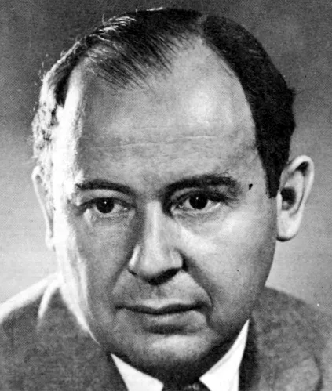
Overview of Computing Pioneers
John von Neumann (1903 - 1957)
Went to University of Berlin and University of Hamburg
Contributing to the development of the atomic bomb during WWII and hydrogen bomb
Significance in the development of the von Neumann architecture, the basic design of most computers today
This architecture separates the program instructions and data into memory
Worked in game theory (Decision making algorithms and strategy)
Blueprint for modern computing systems
Shapes our understanding and development of computers

Slide 8
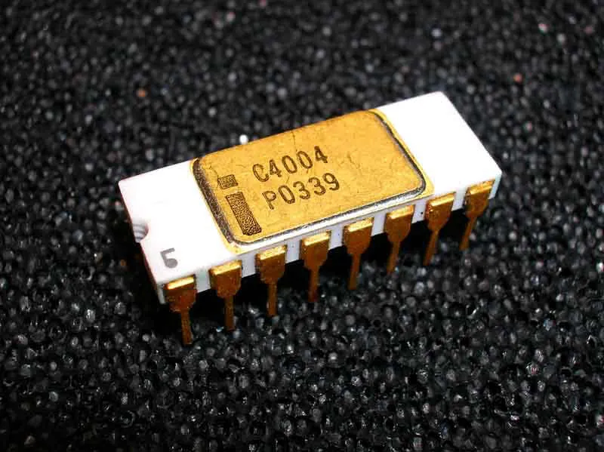
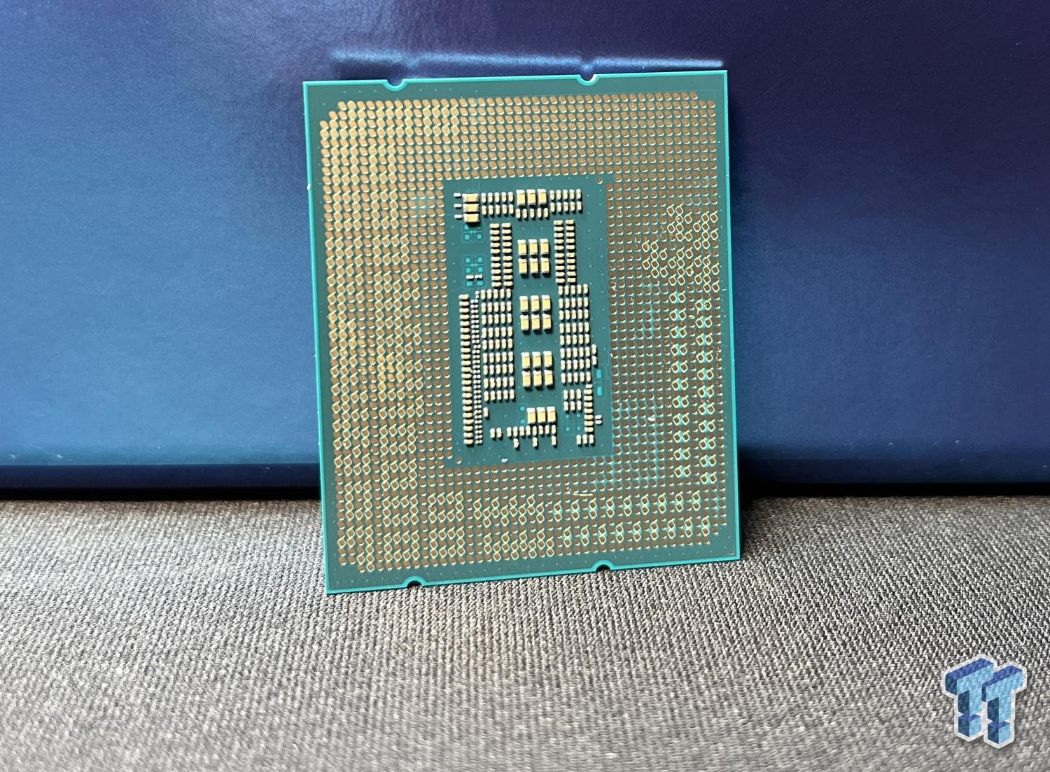
1960s-1970s: The Rise of Personal Computing
Intel’s 4004 Microprocessor:
First to put an entire CPU on one chip
Making computers smaller and more affordable/accessible
While the 4004 was relatively basic by today's standards, it represented a leap in computing power at the time
It has the ability to perform calculations and execute instructions
It led to the rapid advancement of microprocessor technology
Innovation that revolutionized computing by guiding the era of microprocessors
Its creation has lead to the most powerful CPU’s that we see today
Intel continue to release even more powerful CPU’s

Slide 9
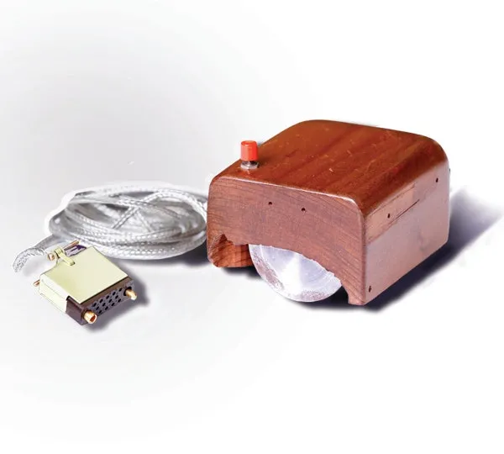
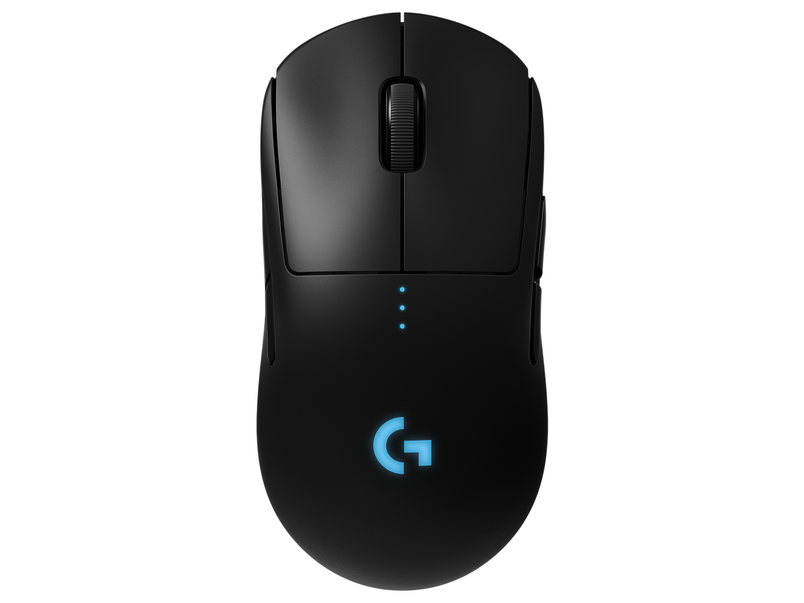
1960s-1970s: The Rise of Personal Computing
Doug Engelbart mouse:
In 1964, Engelbart’s idea of a pointing device that could move a cursor on a screen
Before the mouse to interact with the computer we used commands or punch cards
User-friendly interaction - Provided a way to interact with GUI
Point and click navigation - Allowed us to point at graphical elements on the screen and click to select/activate them
For his idea it would lead to the mice we have come to know and how we navigate OS systems and browse the web today
Evolution of other input devices such as trackpads, touchscreens

Slide 10
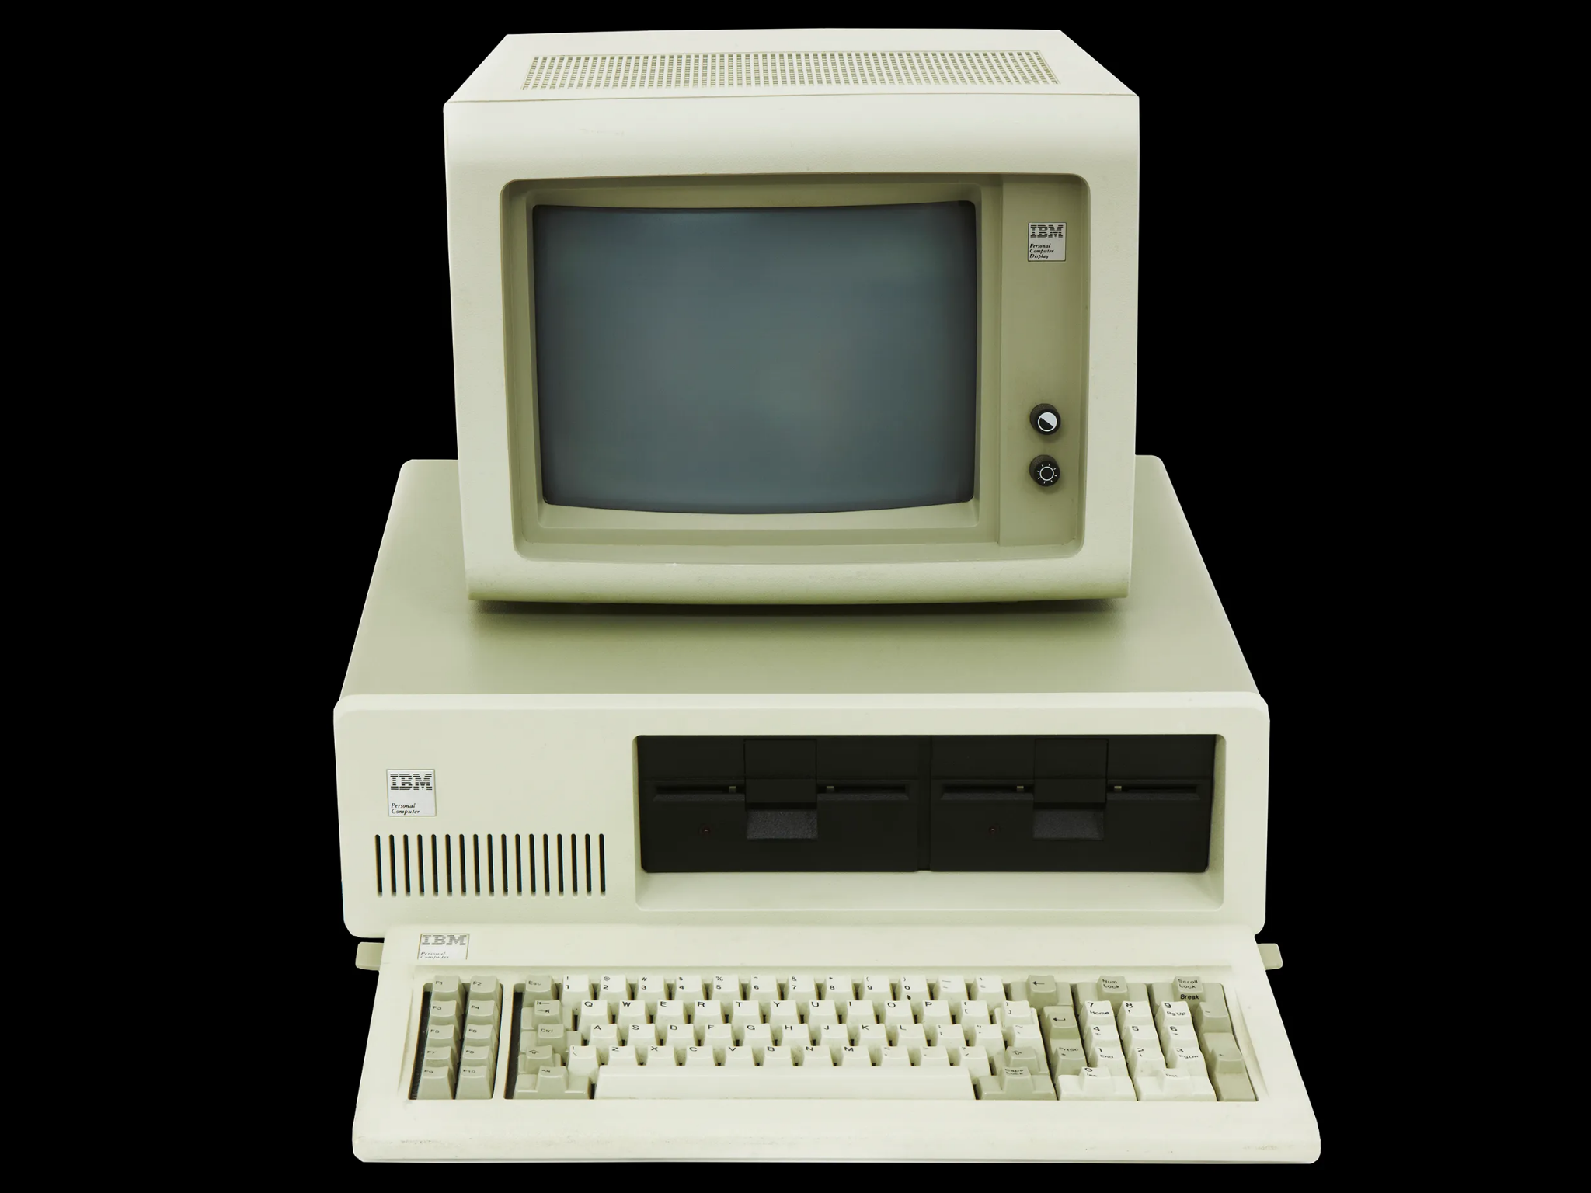
1980s: The PC Revolution
IBM PCs
Powered by the Intel 8088 processor and running MS-DOS
Blueprint for many subsequent PC’s
Boosting productivity and automation
Creation of a wide compatibility of hardware and software
Design and open standards heavily influenced the growth of the computer industry
OS: Worked with Microsoft to develop MS DOS
Graphical interface, setting a new standard for user friendly interface
Set standards in modern computing and influences the new os system to come like windows 11

Slide 11
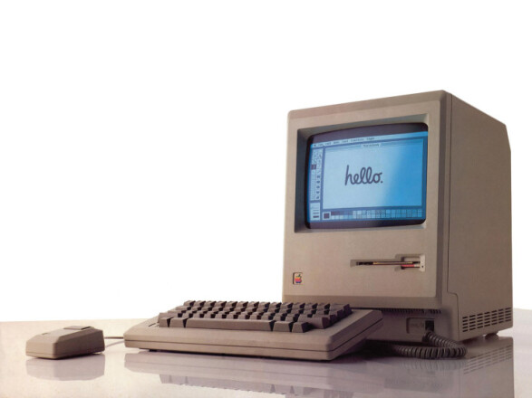
1980s: The PC Revolution
Apple PCs
Released Apple(III) which had lots of defects that would deform the motherboard and break machine
After the failure of the apple (III) they released Macintosh - Mouse and window functionality into a smaller lighter computer
Was a great success and they continued to work and improve on it releasing more ram, newer models over time
It had a big impact on modern computing because it was the skeleton of the microsoft competitor that is still improving upon that OS to this day

Slide 12
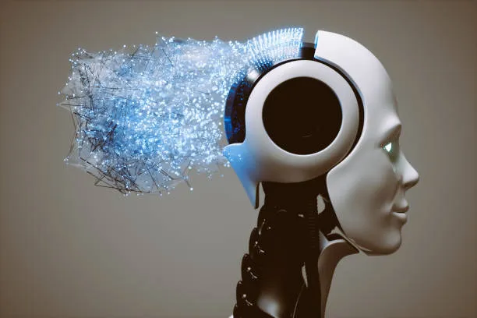
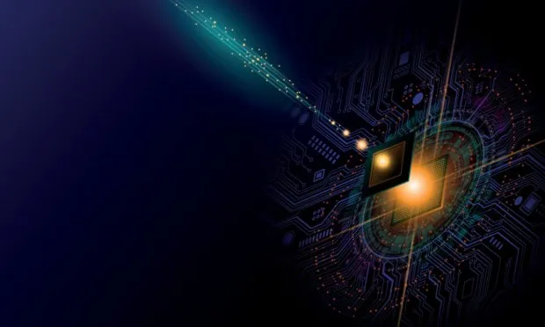
Present Day and Emerging Areas
AI and machine learning
Significant progress in deep learning techniques, natural language processing, computer vision, and reinforcement learning
Scientists are working on developing more stable qubits, improving quantum algorithms
Turing's work laid the foundation for theoretical computer science and computation theory and it was fundamental in understanding the limits of computation, which influences AI and quantum algorithms' development

Slide 13

Prospects in Computer Science Careers
Offers a wide variety of career opportunities so that you will surely find what you are looking for and what you want to do
They’re plenty of different companies in the world of computer science that are competing against each other
Diverse opportunities
Remote work
Interdisciplinary skills has become incredibly important in our job market today
They need professionals that can adapt to diverse challenges like problem solving, innovation creativity and collaboration and communication
Projected to grow 23 percent from 2022 to 2032

Slide 14
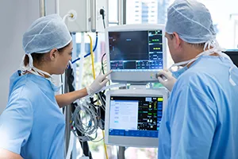

Prospects in Computer Science Careers
AI algorithms are revolutionizing healthcare by enhancing diagnostics, AI can analyze medical images and predict diseases leading to faster and more accurate diagnostics
improve security systems and threat detection in cyber attacks
Quantum computers have the capability to solve complex problems exponentially faster impacting in fields like cryptography
Game designer/developer if you want to bring your creativities to life
Web designer if you want to help in creating websites
Looking at the change in data doing data analytics
Cloud computing - Servers and storage

Slide 15
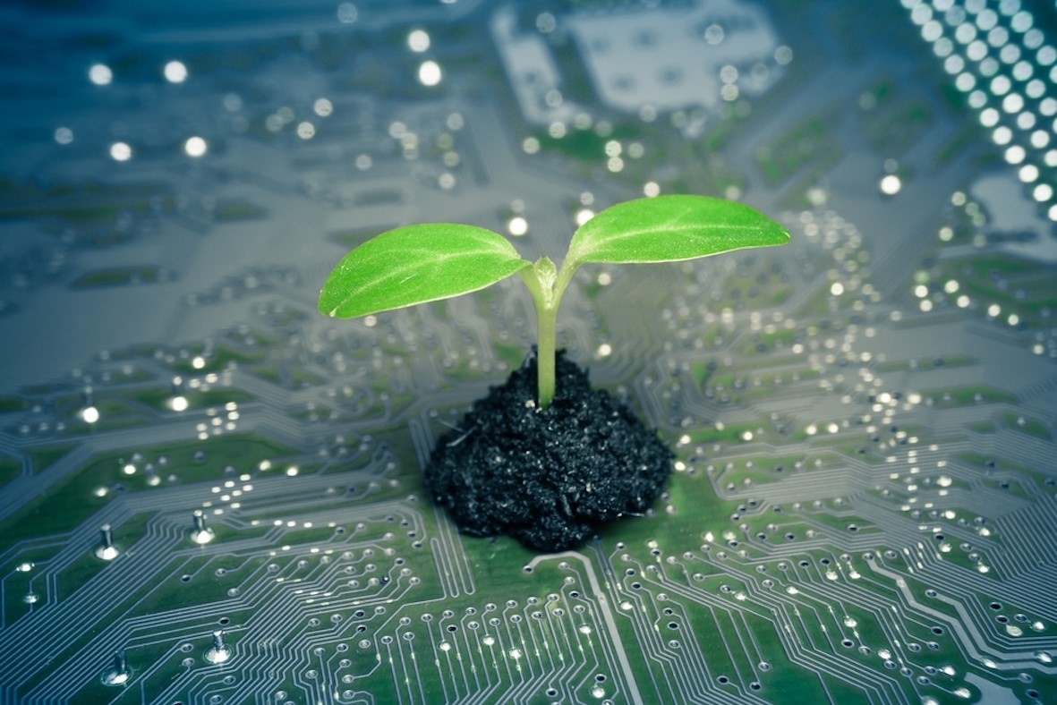

Computer Environment
Energy-Efficient Computing: Governments and organizations encourage the use of energy-efficient hardware and software
E-Waste Management: Policies focus on the responsible disposal and recycling of e waste.
Data Center Efficiency: Policies may target data centers, aiming to improve their energy efficiency
Telecommuting and Remote Work: Encouraging telecommuting and remote work policies reduces the need for commuting, thereby decreasing carbon emissions

Slide 16
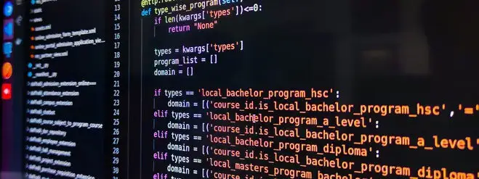

Conclusion
Without these early computers and algorithms we would have the computer we have come to know today
Computers have a big impact on fields like healthcare, finance and education because of AI, Quantum computers and machine learning
There are many career paths in computer science such as Artificial Intelligence, cybersecurity, software development, data science, and so much more
The field is constantly evolving, creating room for innovation and problem-solving

Slide 17
References
Britannica. (n.d.). Alan Turing. In Encyclopedia Britannica. Retrieved November 19, 2023, from https://www.britannica.com/biography/Alan-Turing
Encyclopedia Britannica. (n.d.). John von Neumann. Encyclopedia Britannica. Retrieved November 19, 2023, from https://www.britannica.com/biography/John-von-Neumann
Wikipedia contributors. (n.d). Douglas Engelbart. Wikipedia, The Free Encyclopedia. Retrieved November 19, 2023, from https://en.wikipedia.org/wiki/Douglas_Engelbart
Wikipedia contributors. (n.d). Intel 4004. Wikipedia, The Free Encyclopedia. Retrieved November 19, 2023, from https://en.wikipedia.org/wiki/Intel_4004
Wikipedia contributors. (n.d). IBM Personal Computer. Wikipedia, The Free Encyclopedia. Retrieved November 19, 2023, from https://en.wikipedia.org/wiki/IBM_Personal_Computer
Wikipedia contributors. (n.d). Mac (computer). Wikipedia, The Free Encyclopedia. Retrieved November 19, 2023, from https://en.wikipedia.org/wiki/Mac_(computer)
Wikiwand. (n.d.). EDVAC. Retrieved November 21, 2023, from https://www.wikiwand.com/en/EDVAC

Slide 18
References
Wikipedia contributors. (n.d). Colossus computer. Wikipedia. Retrieved November 21, 2023, from https://en.wikipedia.org/wiki/Colossus_compute
Wikipedia contributors. (n.d). History of Microsoft. Wikipedia, The Free Encyclopedia. Retrieved November 19, 2023, from https://en.wikipedia.org/wiki/History_of_Microsoft
Tecnet. (n.d.). Environmental Stewardship. Retrieved November 19, 2023, from https://tecnet.ca/about-us/environmental-stewardship/r
Encyclopædia Britannica. (n.d.). ENIAC. Retrieved November 21, 2023, from https://www.britannica.com/technology/ENIAC
Wikipedia contributors. (n.d). UNIVAC I. Retrieved November 21, 2023, from Wikipedia. https://en.wikipedia.org/wiki/UNIVAC_I

